Slide 1
Closure Properties and Pumping Lemma for Regular languages
V.Vijayarajan
Assistant Professor
SCSE, VIT University
Vellore

Slide 2
We have proven
Regular languages are closed under:
Union
Concatenation
Star operation
Reverse
1

Slide 3




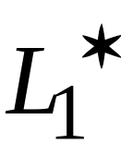
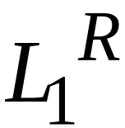
Namely, for regular languages and :
Union
Concatenation
Star operation
Reverse
Regular
Languages

Slide 4
We will prove
Regular languages are closed under:
Complement
Intersection

Slide 5


Namely, for regular languages and :
Complement
Intersection
Regular
Languages

Slide 6


Complement
Theorem:
For regular language
the complement is regular
Proof:
Take DFA that accepts and make
  nonfinal states final
  final states nonfinal
Resulting DFA accepts

Slide 7
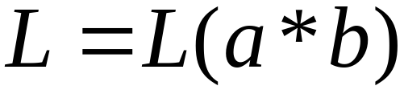






Example:

Slide 8

Intersection
Theorem:
For regular languages and
the intersection is regular
Proof:
Apply DeMorgan’s Law:

Slide 9
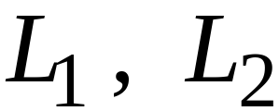
regular
regular
regular
regular
regular

Slide 10
Standard Representations
of
Regular Languages

Slide 11
Standard Representations of Regular Languages
Regular Languages
DFAs
Regular
Grammars
NFAs
Regular
Expressions

Slide 12
When we say:
We are given
a Regular Language
We mean:
Language is in a standard
representation

Slide 13
Elementary Questions about
Regular Languages

Slide 14


Membership Question
Question:
Given regular language
and string
how can we check if ?
Answer:
Take the DFA that accepts
and check if is accepted

Slide 15


DFA
DFA

Slide 16
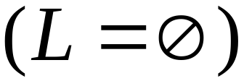
Question:
Given regular language
how can we check
if is empty: ?
Answer:
Take the DFA that accepts
Check if there is a path from
the initial state to a final state

Slide 17


DFA
DFA

Slide 18
Question:
Given regular language
how can we check
if is finite?
Answer:
Take the DFA that accepts
Check if there is a walk with cycle
from the initial state to a final state

Slide 19
DFA
is infinite
DFA
is finite

Slide 20

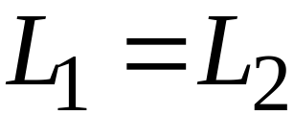
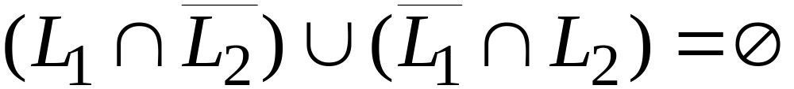
Question:
Given regular languages and
how can we check if ?
Answer:
Find if

Slide 21
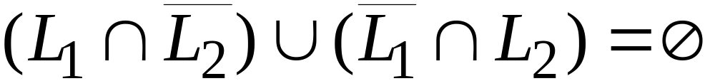
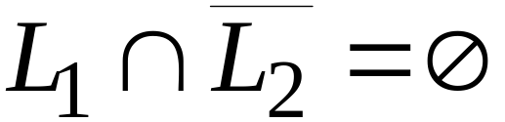
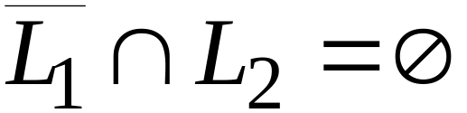
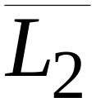
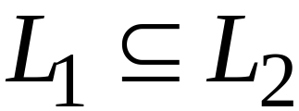
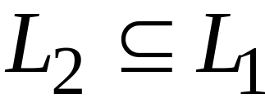
and

Slide 22
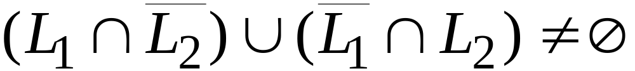
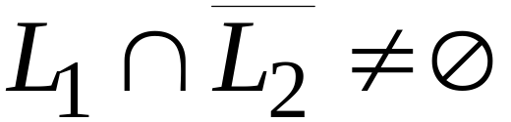
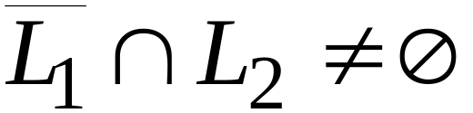
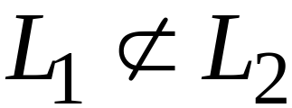
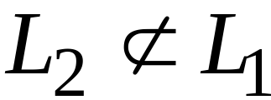
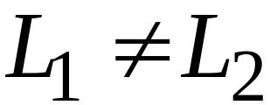
or

Slide 23
Non-regular languages

Slide 24
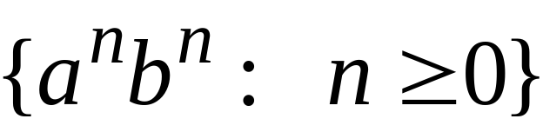



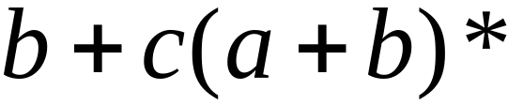

Non-regular languages
Regular languages

Slide 25
How can we prove that a language
is not regular?
Prove that there is no DFA that accepts
Problem: this is not easy to prove
Solution: the Pumping Lemma !!!

Slide 26

The Pigeonhole Principle

Slide 27


pigeons
pigeonholes

Slide 28
A pigeonhole must
contain at least two pigeons

Slide 29



pigeons
...........
pigeonholes
...........

Slide 30
The Pigeonhole Principle
pigeons
pigeonholes
There is a pigeonhole
with at least 2 pigeons
...........

Slide 31
The Pigeonhole Principle and
DFAs

Slide 32




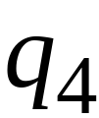


DFA with states

Slide 33
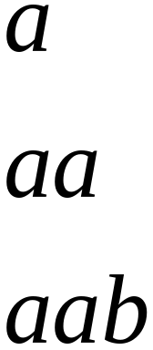
In walks of strings:
no state
is repeated

Slide 34
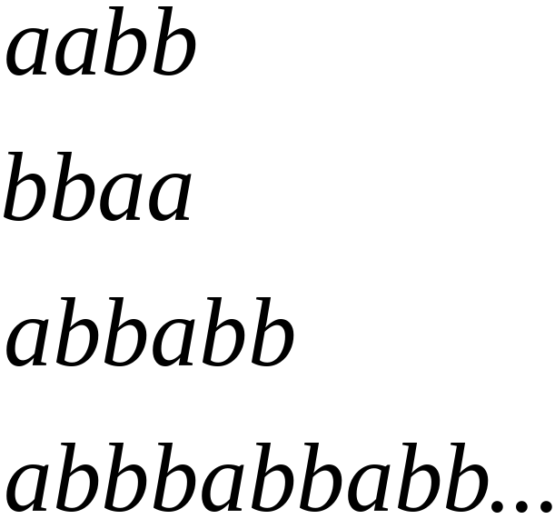
In walks of strings:
a state
is repeated

Slide 35
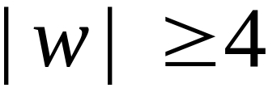
If the walk of string has length
then a state is repeated

Slide 36

Pigeonhole principle for any DFA:
If in a walk of a string
transitions states of DFA
then a state is repeated

Slide 37

In other words for a string :
transitions are pigeons
states are pigeonholes

Slide 38

In general:
A string has length number of states
A state must be repeated in the walk
walk of
......
......

Slide 39
The Pumping Lemma

Slide 40

Take an infinite regular language
DFA that accepts
states

Slide 41
Take string with
There is a walk with label :
.........
walk

Slide 42
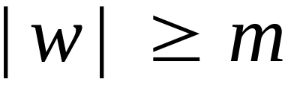
If string has length
number
of states
then, from the pigeonhole principle:
a state is repeated in the walk
......
......
walk

Slide 43




Write
......
......

Slide 44


Observations:
length
number
of states
length
......
......

Slide 45

Observation:
The string is accepted
......
......

Slide 46

Observation:
The string
is accepted
......
......

Slide 47

Observation:
The string
is accepted
......
......

Slide 48
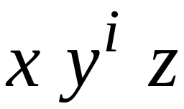

In General:
The string
is accepted
......
......

Slide 49
In other words, we described:
The Pumping Lemma !!!

Slide 50


The Pumping Lemma:
Given a infinite regular language
there exists an integer
for any string with length
we can write
with and
such that:

Slide 51
Applications of the Pumping Lemma

Slide 52

Theorem:
The language
is not regular
Proof:
Use the Pumping Lemma

Slide 53
Assume for contradiction
that is a regular language
Since is infinite
we can apply the Pumping Lemma

Slide 54
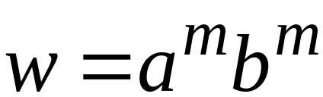
Let be the integer in the Pumping Lemma
Pick a string such that:
length
Example:
pick

Slide 55
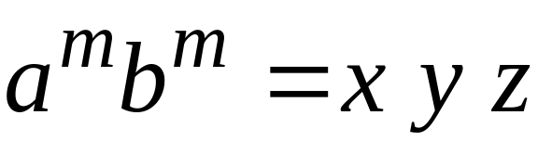

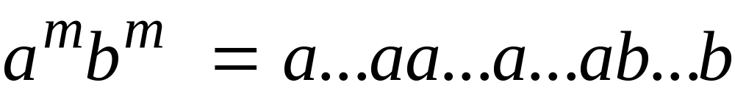
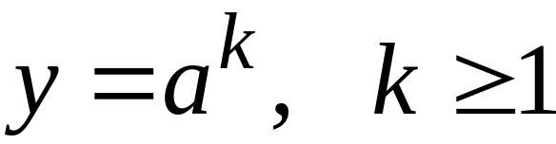
Write:
From the Pumping Lemma
it must be that: length
Therefore:

Slide 56
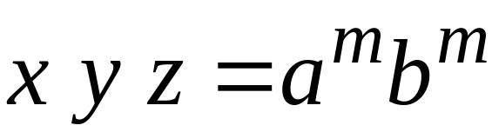

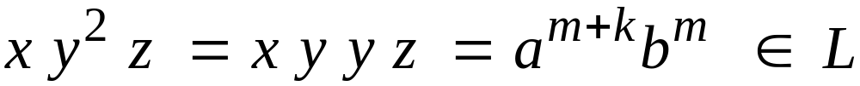
We have:
From the Pumping Lemma:
Thus:

Slide 57
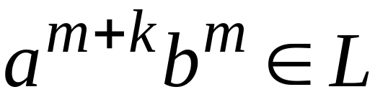
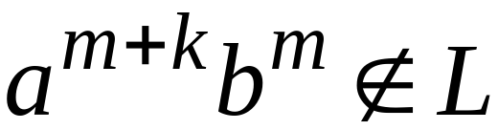
Therefore:
BUT:
CONTRADICTION!!!

Slide 58
Therefore:
Our assumption that
is a regular language is not true
Conclusion:
is not a regular language

Slide 59
Non-regular languages
Regular languages

